Slide 1

The Dog House
Social Media Plan

Slide 2
Social Media Platforms
The Dog House should invest in advertising on the following platforms:
Facebook
Instagram
Additionally, it is recommended to add an Instagram button to the website along with the Facebook button.

Slide 3
Ad Budget - Facebook
Boost Post advertisement
Suggest starting ad campaign for 14 days to measure results.
Cost: $1/day * 14 days = $14
Good way to increase visibility of page by increasing the audience that sees posts

Slide 4
Ad Budget - Instagram
Photo Ad
Set a budget
Ad will run until that budget has been met
Recommend starting low:
$.50 per click with an overall budget of $100 will allow 200 users to interact with the ad

Slide 5
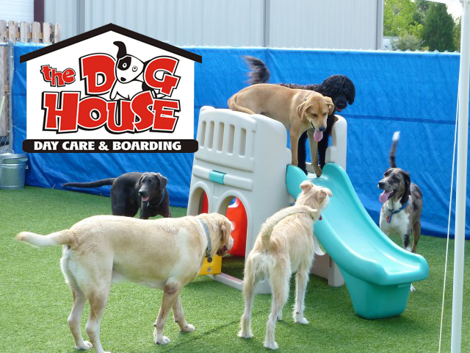
Sample
Using pictures from posts and adding the logo to them is a good way to push brand recognition.

Slide 6
Hootsuite
Effective way to improve presence across multiple social media platforms.
Starts at $29/month, billed yearly
30-day free trial to measure effectiveness
Schedule automatic content posting across multiple platforms
Engage with audience
Track success with analytics

Slide 7
Remember
Investing in your brand by promoting content returns dividends and increased business!

